Slide 1
Project Defence on
Online Clothing Store
Presented By:
Roll No:676
Name:ghjghjb
Roll No:767
Date:778
College Name: Aadim National College

Slide 2
Introduction
Create a unique shopping experience that offers high-end fashion, personalized customer service, and curated collections of clothing from top luxury brands.

Slide 3
Problem Statement
Online shopping charge high than agreed such as additional delivery charge.
Online shopping found to be giving wrong description about product such as poor quality of product.

Slide 4
Objectives
To provide the information of products.
To showcase the products of the shop along with their prices.
To provide convenient shopping from home.

Slide 5
Limitations
Unable to try on clothes and see the fabric or fit in person.
Risk of receiving damaged or incorrect items.
Customer cannot bargain.

Slide 6
Tools Required
Frontend tool: Html and CSS
Backend tool: PHP
Database: MySql
Server: Apache
Text Editor: Vs Code

Slide 7
Feasibility Study
Technical Feasibility: To design this system, it uses existing technologies, software, and hardware so there is no technological hurdle to building this system. All the required technologies are easily available to us.
Economic Feasibility: The system does not require extra software and hardware i.e. it uses opensource technologies. So, there is no recurring cost than just the internet connection.
Operational feasibility: All the required operations such as internet service are available and there isn’t any legal issue. So, this project can be considered operationally feasible.

Slide 8
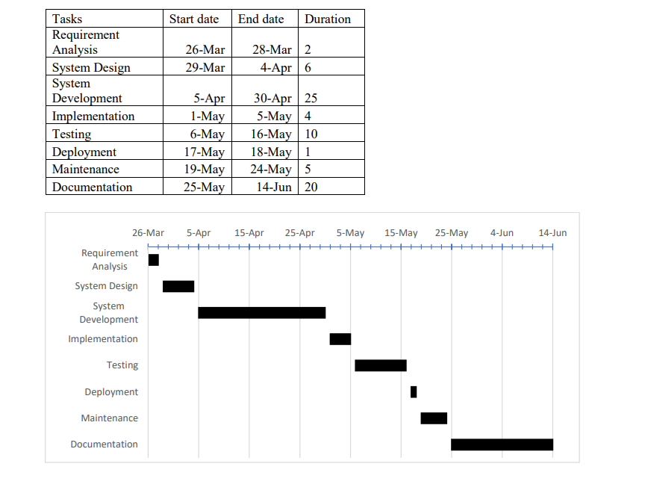
Gantt Chart

Slide 9
Expected Outcome
Attract customer and increase customer collection.
Improve customers experience.
Customers can easily buy and get clothes from respected stores to their places effortlessly

Slide 10
Conclusion
In this way we design a Online Clothing Store using the existing technology and resources available with us.

Slide 11
Thank you

